Slide 1
Stellar Classification
Dylaan Cornish, Henry Fernandez, and Renato Tizon

Slide 2
Table of contents
01
02
03
04
05
06
Executive Summary
Problem Statement
EDA
An overview of the stellar classification project
Detailing the clients request for our analytics team
Exploring and preparing the Kaggle stellar classification dataset.
Methodology
Results
Solution
Describing our model selection process.
Comparing the accuracy & train times of our models
Presenting our recommendation for our chosen model

Slide 3
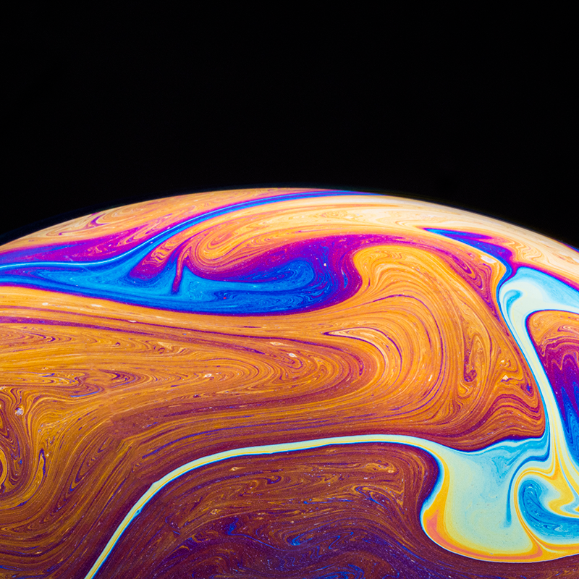
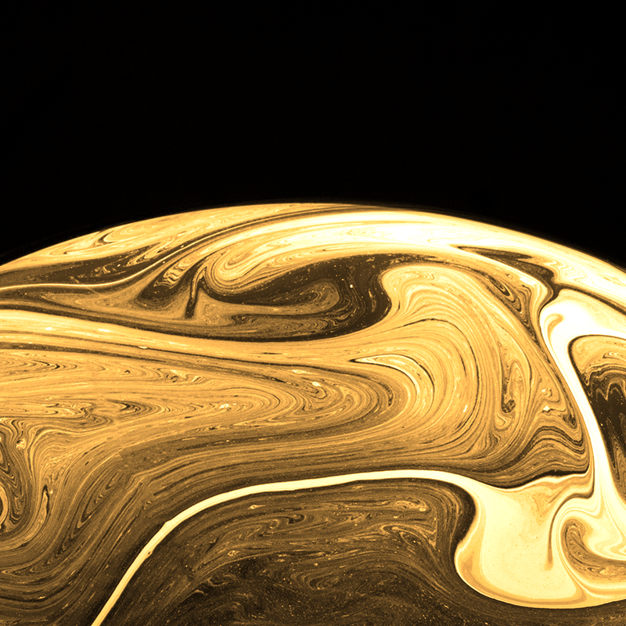
01 & 02
Executive Summary and Problem Statement

Slide 4
Executive Summary
In this notebook, our analytics team consisting of Henry Fernandez, Dylaan Cornish and Renato Tizon explores the Stellar Classification dataset from Kaggle to perform multi-class classification per the request of our client, a small astronomical observatory.
We implement 3 simple classification models, 2 ensemble classification models, and 1 artificial neural network. The classification accuracy and run-time are calculated for each model and compared against one-another in order to choose the most optimal model for the task. Ultimately, Decision Tree Classifier stands out as the best model stellar classification.

Slide 5
Problem Statement & Research Objectives
Our client is an astronomical observatory that runs a publication about astronomical events, cosmology, planets, galaxies, asteroids, astrophotography.
They have a stellar classification dataset of 100,00 observations, with information on the objects Right Ascension, declination, UGRIZ, Redshift and other features.
The client wants to use Machine Learning to determine whether what they're observing is a Star, a Galaxy, or a Quasi-Stellar Object (QSO) (QSO is class of objects beyond our Milky Way Galaxy that have a starlike visual appearance except that the optical spectrum has a large redshift).
This is a small observatory with limited resources and funding. They've hired us as data scientists to build the best model in performing this classification WITHOUT using too much computational power and runtime. In short, they want us to build the simplest and best possible model to perform the classification they need. Our research objective is to compare both the accuracy and speed of each model and determine the best one for this astronomical observatory and their limited resources and time constraints.

Slide 6
03
EDA

Slide 7
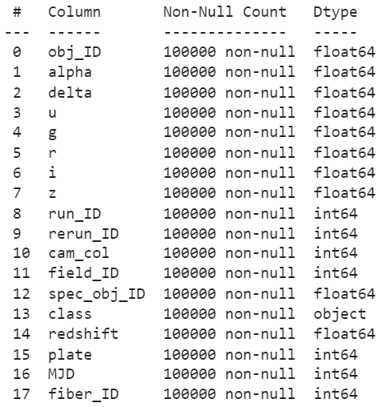
Dataset
Alpha & Delta:
The astronomical equivalents of longitude and latitude
Photometric Letters:
Each letter designates a section of light of the electromagnetic spectrum
Redshift:
An increase in the wavelength of electromagnetic radiation

Slide 8
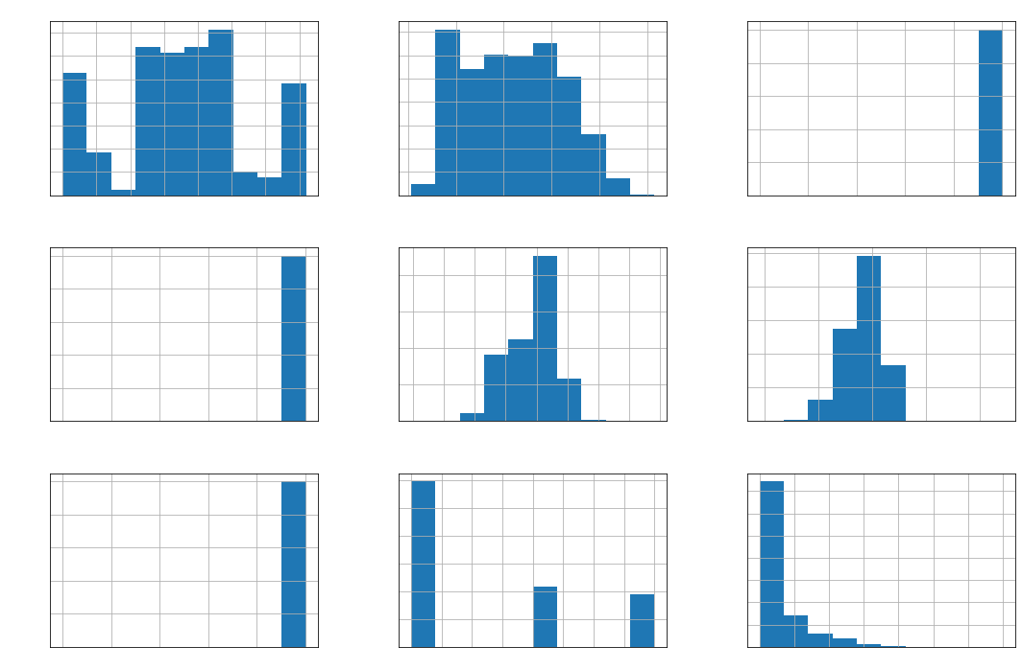
Exploring Distributions

Slide 9
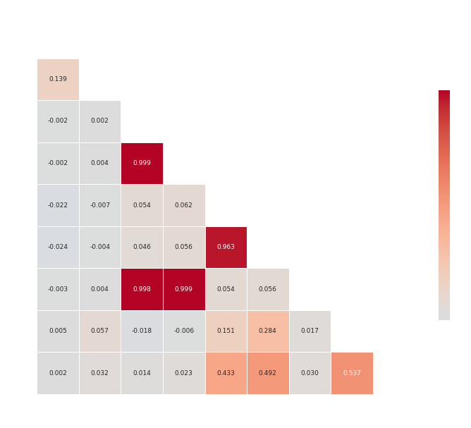
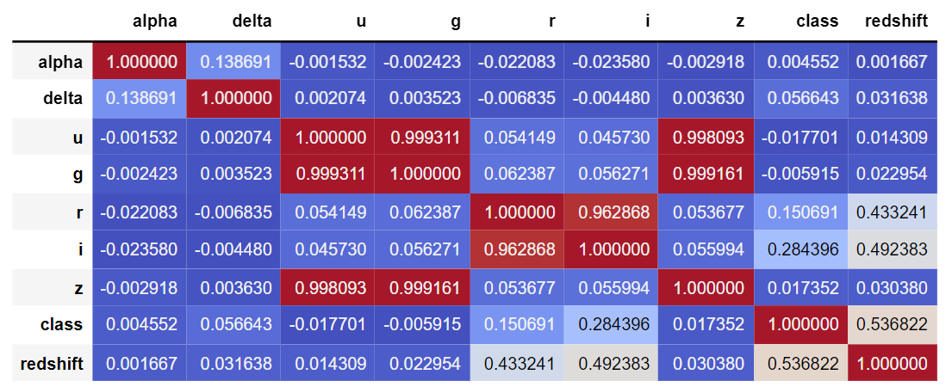
Exploring Correlation Heatmaps

Slide 10
Feature Engineering and Data Preparation
Over the course of our exploratory data analysis, our analytics team made the following data preparation decisions before moving onto the modeling stage:
Dropping the columns: "rerun_ID", "obj_ID", "run_ID", "field_ID", "fiber_ID", "spec_obj_ID", "MJD", "plate", and "cam_col" as they were all ID-related fields and would thus contribute to overfitting and do not contain predictive value.
Normalize all Photometric Letter values (U,G,R,I,Z) by applying MinMax scaling.
Notes:
id_cols = ['rerun_ID','obj_ID','run_ID','field_ID','fiber_ID','spec_obj_ID']
data = data.drop(id_cols, axis = 1)
useless = ['MJD', 'plate', 'cam_col']

Slide 11
04
Methodology

Slide 12
Six models were tested for optimal classification
Simplest Models:
1. KNN
2. Naïve Bayes
3. Decision Tree
Ensemble Models:
4. Random Forest
5. Gradient Boost
Neural Network:
6. Feedforward Neural Net
Our analytics team is looking for the most optimal model in terms of accuracy and training time.

Slide 13
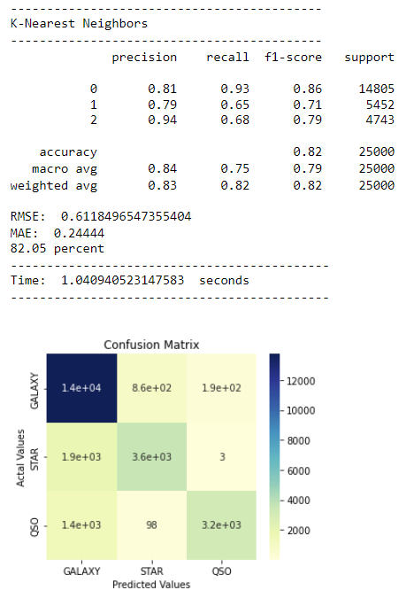
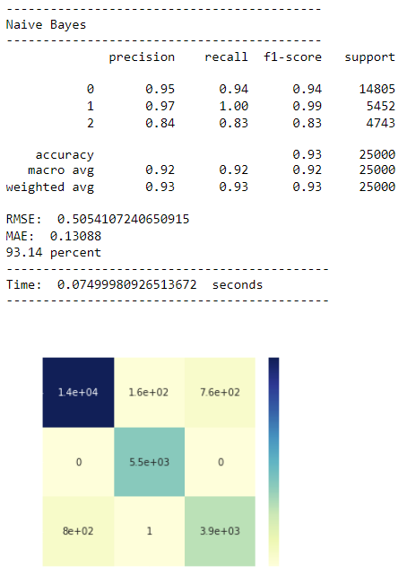
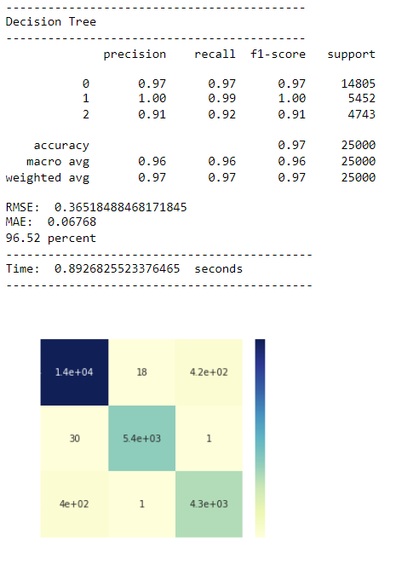
Simplest Models

Slide 14
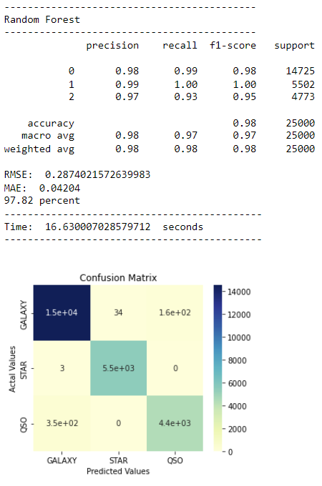
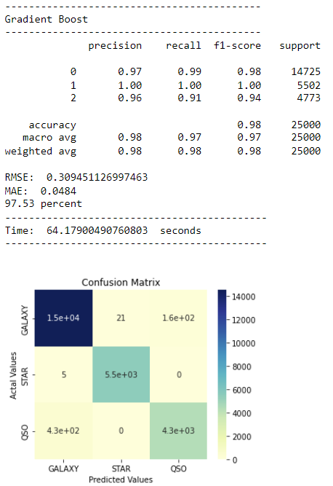
Ensemble Models

Slide 15
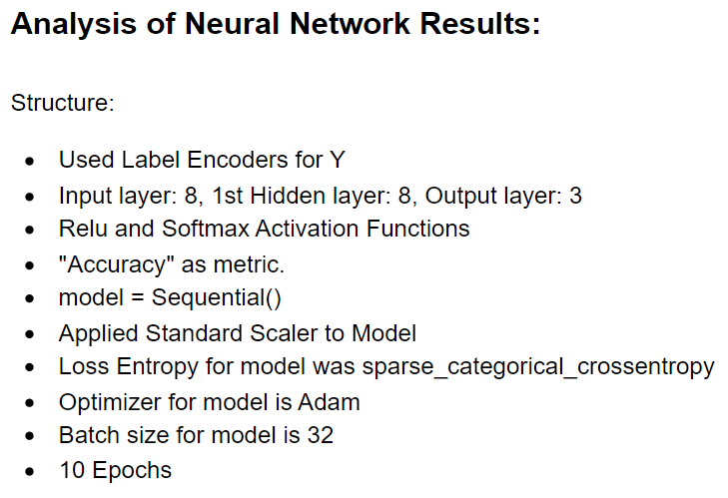
Neural Network

Slide 16
05
Results

Slide 17
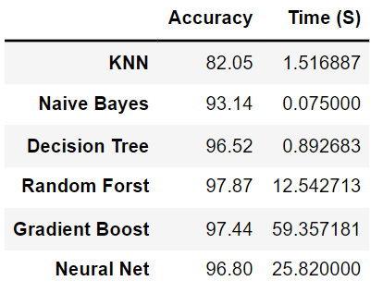
Results
Most models performed quite well. However, Decision Tree offers the best accuracy for the shortest training time, which is best suited for the needs of the observatory.

Slide 18
06
Solution & Recommendation

Slide 19
Overall Analysis & Recommendation to Client
After performing our exploratory data analysis, feature engineering, building and testing a set of simple models, ensemble methods, and a Neural Network, our data science team has a recommendation for the client. We suggest the client moves forward with implementing a Decision Tree classifier as their method of determining whether what they're observing is a Star, a Galaxy, or a Quasi-Stellar Object. The only necessary features are alpha, delta, u-g-r-i-z and redshift. We've come to this conclusion by analyzing each model's accuracy measures, classification reports, and confusion matrices. We've kept their resource constraints in mind and timed how long it take for each model to run. The combination of extremely-high accuracy and extremely quick run times makes the Decision Tree classifier the best option for this task. An extra percent of accuracy can be gained by using gradient boost or random forest, but these models both take far longer to run.
Moving Forward: This observatory is performing this classification with the tabular data they've collected. This is a good place to begin as they are smaller and have limited resources for much else. Our recommendation for the future for them as they continue to grow is to consider moving towards image classification to perform this same problem. It will be more computationally expensive but could make their publication more robust and provide a new way to obtain these classifications if the data on their alpha, delta, "ugriz" etc. is not available. If they get to the point where they are ready to implement, our analytics team will be on standby ready to develop a Convolution Neural Network whenever needed.

Slide 20
Lessons Learned
The goal of this project was to build 2 different models in each category: "Simple", "Ensemble" and "Neural Network" and compare their performance in correctly classifying the 3 categories as well as their speed in doing so. Our expectation was that the simple models would be the quickest, yet perform the worst, that the ensemble models would take slightly longer to run and perform better, and that the neural network would take significantly longer but return the best accuracy. Our expectation was relatively correct for the most part, but we were surprised a few stages through this process and learned a few things. The accuracy for Decision Tree was much higher than anticipated, proving again that even for this multi-class classification problem, simple models can get the job done at an extremely impressive accuracy. Another lesson learned was the run-times for ensemble methods not being very efficient. The dataset was not terribly large at only 100,000 observations for 8 features, and gradient boost took over a minute to run. Both ensemble methods, as expected, performed exceptionally well. The most surprising result out of this entire process was the speed of the artificial neural network. It was my generally understanding that neural networks will always take longer to run than any simpler ML model, but in this case, it ran start to finish in only 28 seconds, rivaling Random Forest that ran in 14 seconds, and completely beating out gradient boost that took 65 seconds to run. So overall, we've learned that the simple models vary in their ability to accurate classify these 3 objects but perform very quick, and that the accuracy of Ensemble methods and neural networks don't vary very much with this dataset, but their runtimes vary quite a bit.

Slide 21
References
https://www.analyticsvidhya.com/blog/2021/10/implementing-artificial-neural-networkclassification-in-python-from-scratch/ https://www.kaggle.com/datasets/fedesoriano/stellar-classification-dataset-sdss17
https://earthsky.org/astronomy-essentials/what-is-a-redshift/
https://astronomy.stackexchange.com/questions/18986/what-is-the-ugriz-magnitude-system

Slide 22
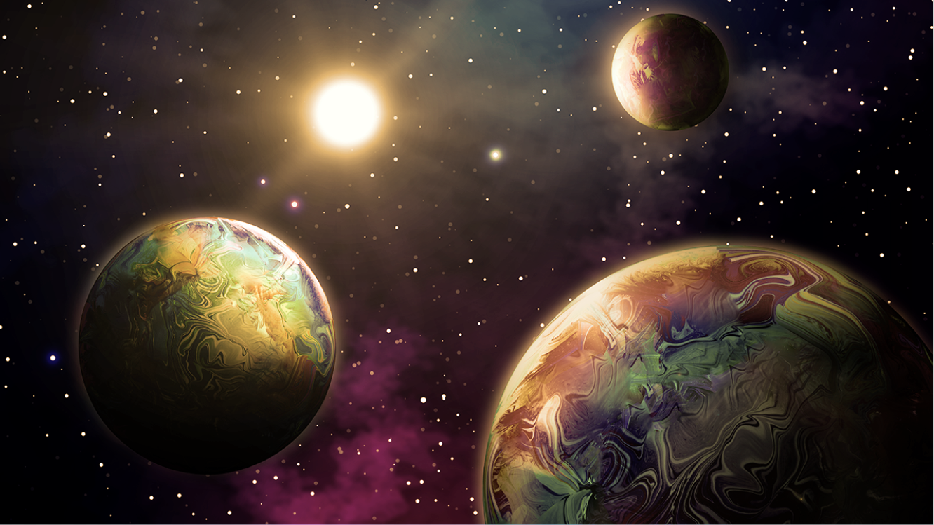
Thank You!

